Slide 1
Steps in Taking Care of Patients with Burns
BY
DR. EZE

Slide 2
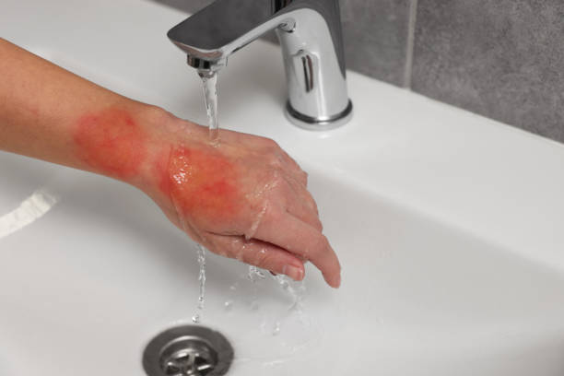
1. Cool the Burn:
- Run cool (not cold) water over the burn for at least 10 minutes.

Slide 3
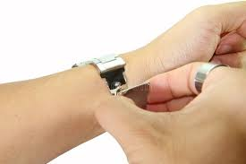
2. Remove Constrictive Items:
- Gently remove jewelry or clothing around the burn area.

Slide 4
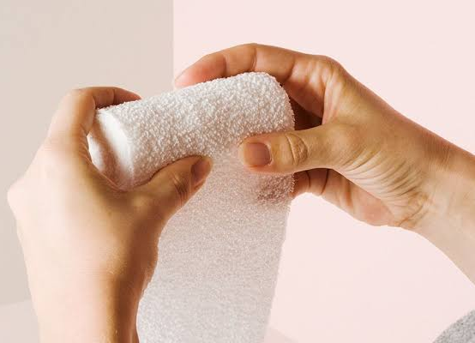
3. Cover the Burn:
- Use a clean, non-stick dressing or cloth.

Slide 5
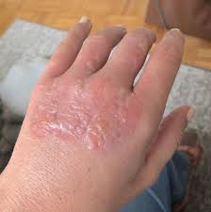
4. Avoid Breaking Blisters:
- Do not pop any blisters.

Slide 6
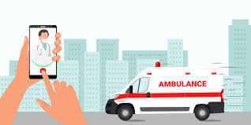
5. Seek Medical Help:
- For severe burns, call emergency services immediately.

